Slide 1


ACTIVITY DIAGRAMS

Slide 2

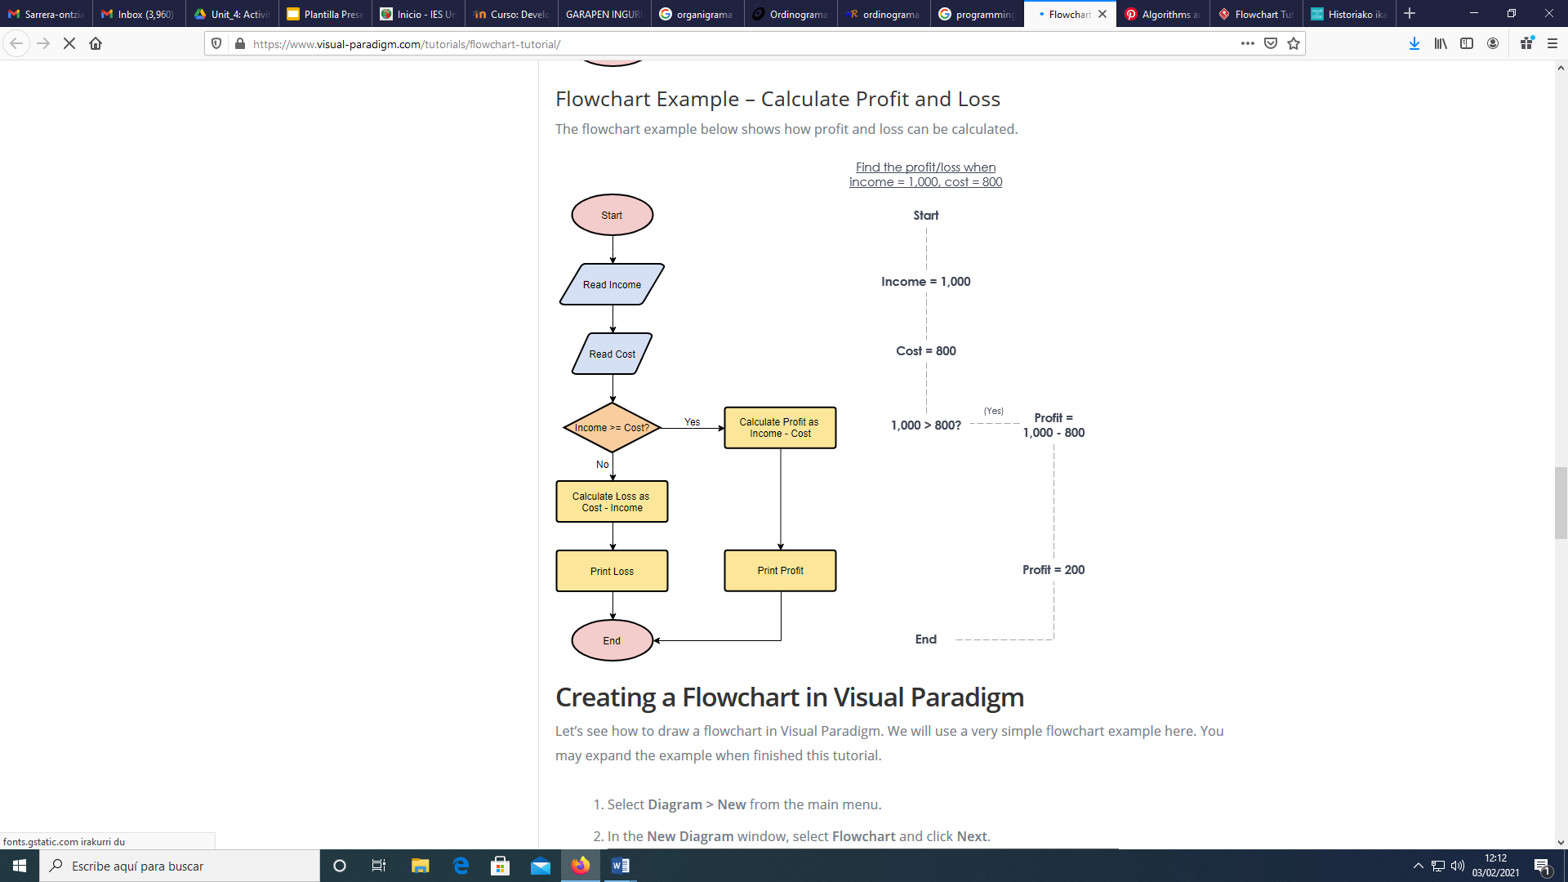
ACTIVITY DIAGRAMS
EXAMPLES

Slide 3
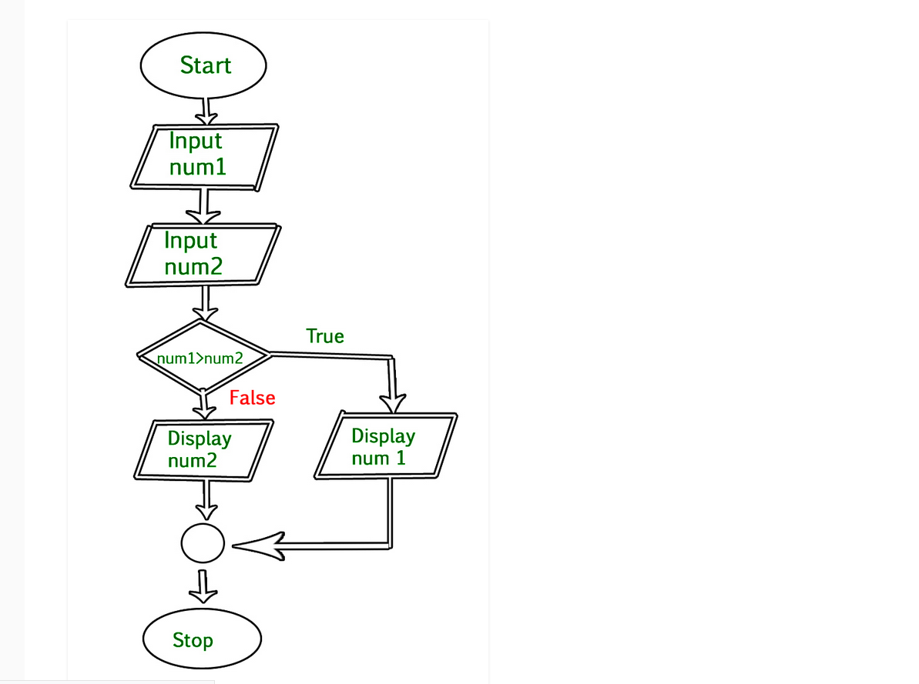
ACTIVITY DIAGRAMS
EXAMPLES

Slide 4
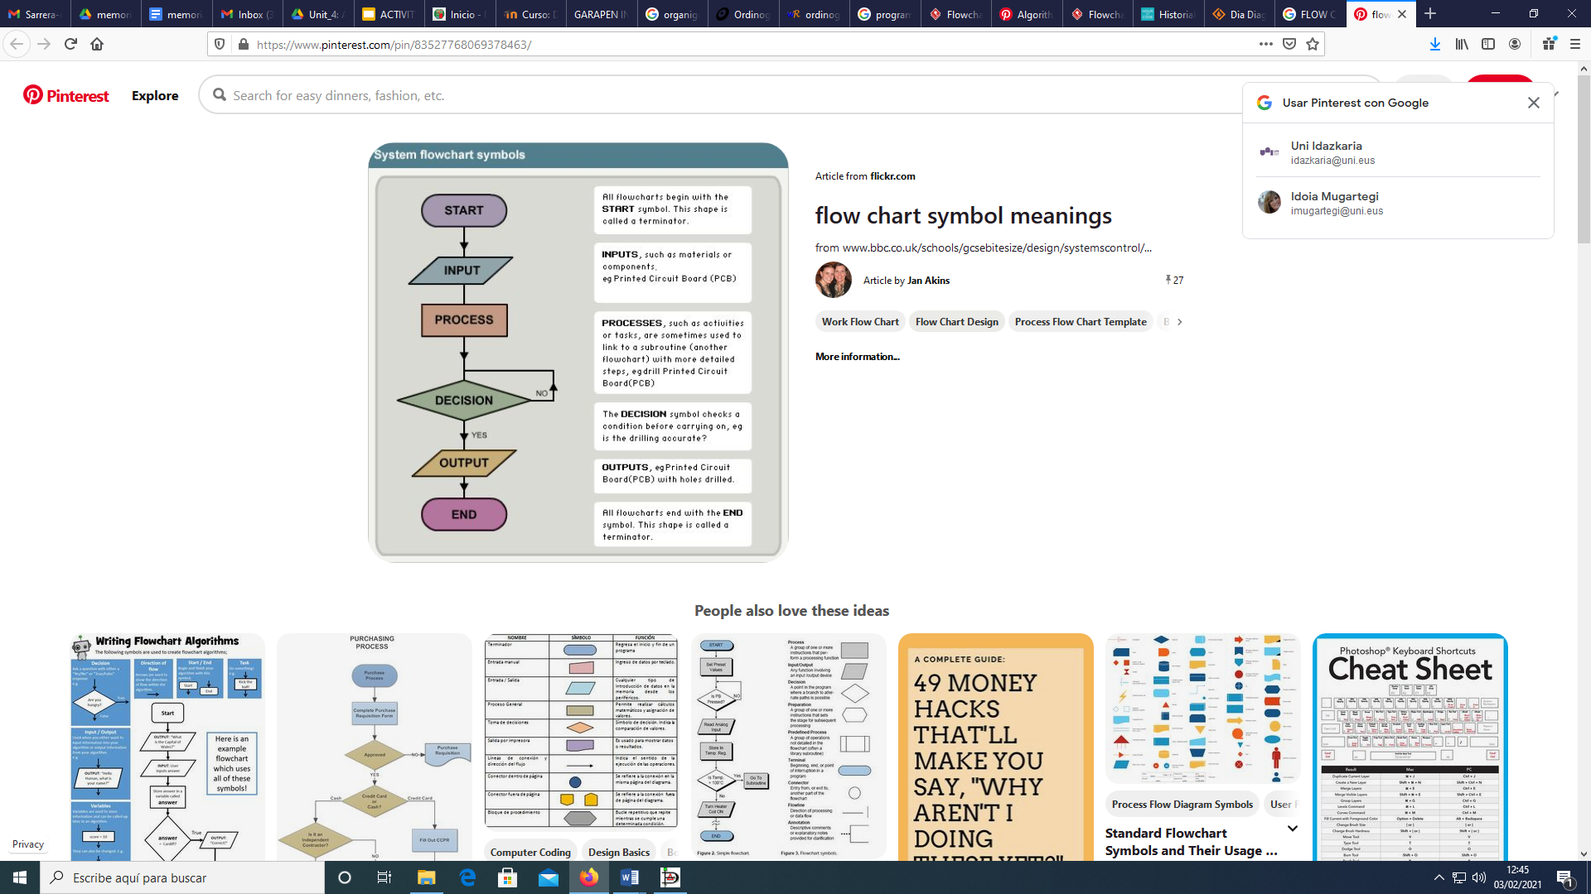
ACTIVITY DIAGRAMS
SYMBOLS

Slide 5
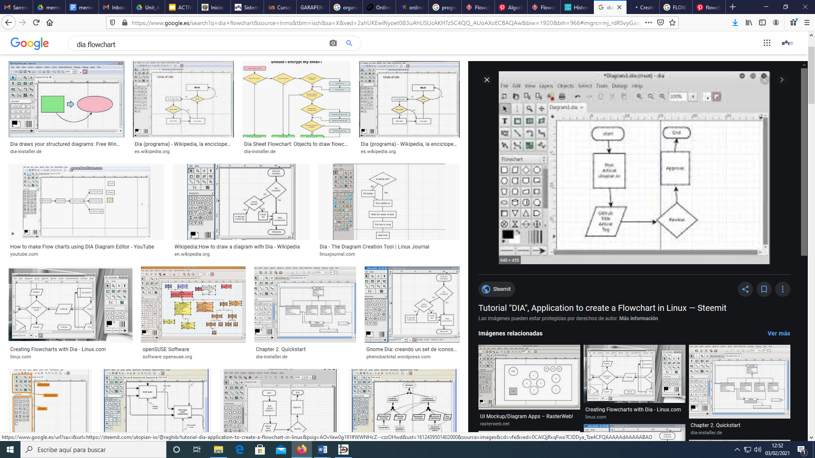
ACTIVITY DIAGRAMS
SOFTWARE: DIA

Slide 6
ACTIVITY DIAGRAMS
Get the activity diagrams of the following statements
Get the addition and multiplication of the even numbers between 20 and 50
Read 15 numbers and say how many are positive.
Calculate the average of 20 numbers introduced from the keyboard.
Read a positive number from the keyboard and say how many digits it has.
Read a number from the keyboard and make a program that displays it backwards.

